Slide 1
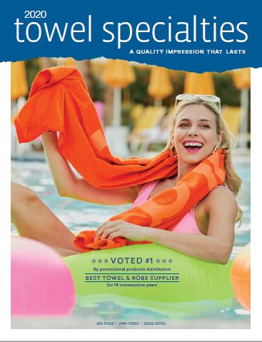
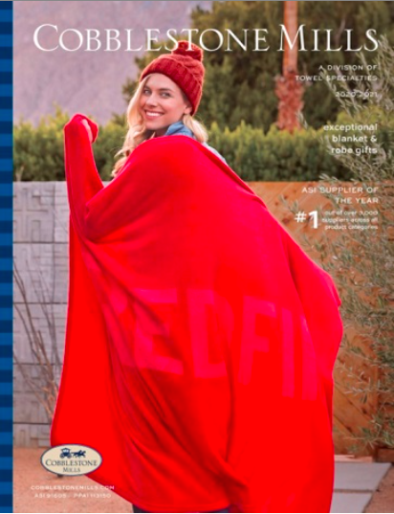
Three outstanding brands from the ASI Supplier of the Year

Slide 2
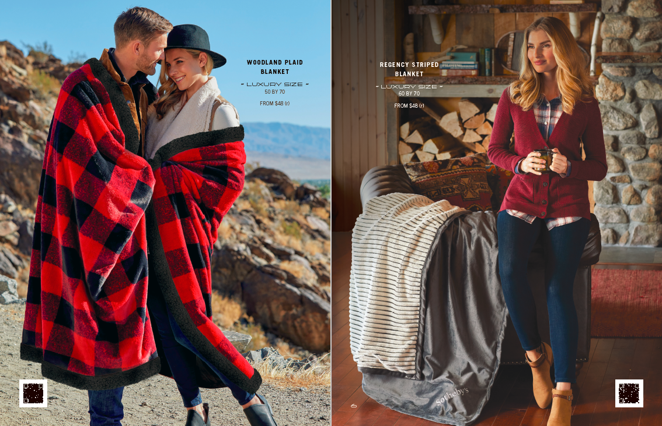
Our new Cobblestone Mills Gift Pick Book

Slide 3
What’s newsworthy?
Counselor Magazine Distributor Choice Award Gold Winner for “Best Supplier” in two categories:
Towels & Robes (15 in a row; 2021-2007)
Blankets (2019 and 2021)

Slide 4
Rocking it with PG today
SPECIAL PRICING 72 unit min achieves EQP
RANDOM SAMPLES WITH SHIPPER
SPEC SAMPLE OFFER REMINDER AT THE END
Award-winning customer service info@towelspecialties.com
We have you covered!
Award-winning field reps…at your service.

Slide 5
Today’s Goal
To introduce you to who buys blankets and beach towels…and how to grow your family business organically.
In other words…to get you more ‘engaged’ with blankets and towels.
Blankets and Towels-to have and to hold them…for many, many years.
Get your client and our products to ‘stay together’ forever.

Slide 6
For your convenience…on every product web page.
SAVE A CALL WITH THIS INFORMATION AT YOUR FINGERTIPS
Up to the minute INVENTORY levels – no password required
Up to the minute PRODUCTION TIMES
Freight estimator

Slide 7
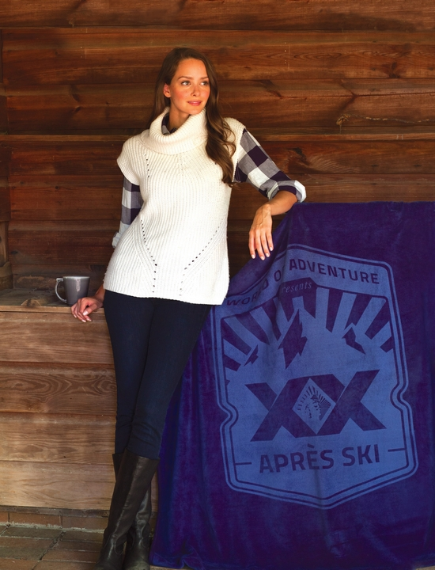
HOTTEST TREND
ESP blanket searches ARE WAY UP!
Blankets are among the fastest growing categories
ESP Towel Specialties blanket searches 2021 v. 2020 increased OVER 110%

Slide 8
#1 application of blankets-HealthCare Professionals
BLANKETS & TOWELS FOR
Nurses
Doctors
Hospital Admin Staff
Cleaning & Janitorial
Kitchen & Cafeteria Workers
EMT & Firefighters
Law Enforcement
FEMA\Red Cross Volunteers
Physical Therapists
Mental Health Counselors
Nursing Home Caregivers
Home Hospice
Cancer Center Staff
Dental Offices & Staff
Vet Clinics

Slide 9
“Social distancing does not mean employees need to feel distanced from their employer.”
Blankets (and towels) are
beloved personal products.
They are the perfect appreciation gift for staff working from their homes.
As well as front line employees to
take home and enjoy.
Make it personal!

Slide 10
Working from home.
It’s still a thing.

Slide 11
Economy West Ship Program
• Coordinate with us so your order ships on the Friday closest to your event date.
• Orders shipping to California, Nevada, Arizona, Colorado, and New Mexico arrive on Tuesday.
• Orders shipping to North Dakota, Washington, Oregon, Montana, Idaho, South Dakota, and Wyoming arrive on Wednesday.

Slide 12
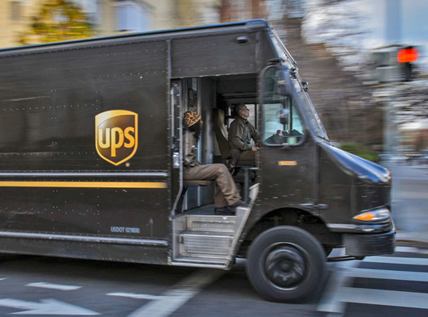
Our 2021 drop shipment program
Special!
Cost is $7.50(v) per product.
Towels and blankets only.
Addresses MUST be submitted in our EXCEL dropship template.
Freight charges still apply per shipment.
You must include “Drop Shipments” as a line item on your purchase order.
Orders of up to 600 pieces are eligible for this program.
Orders require 3-5 additional days beyond standard production time.

Slide 13
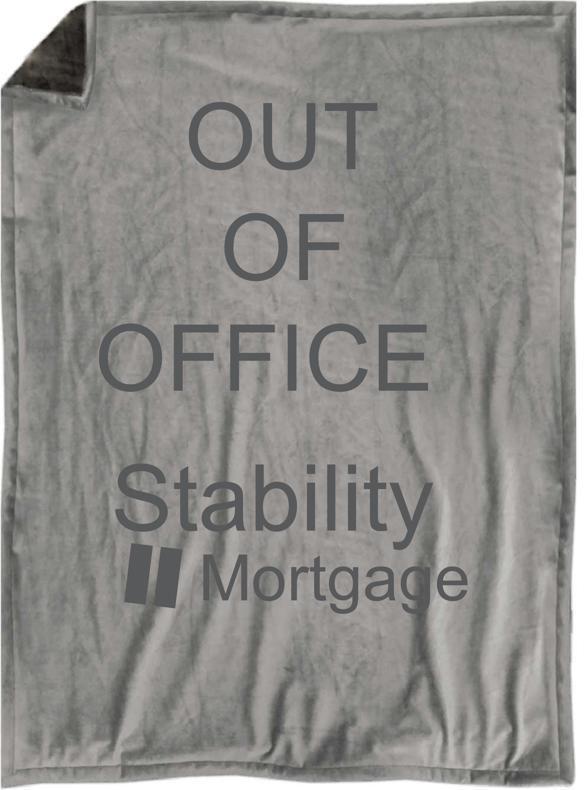
Case History: Blankets & Towels for WFH employees
During the summer, a mortgage group drop shipped both blankets AND towels to staff members working at home.
What were the goals of the company?
To show concern for employee well-being during such a difficult time.
Note that the blankets and towels were so well received that the mortgage company placed re-orders to use as thank you gifts for clients at closing.

Slide 14
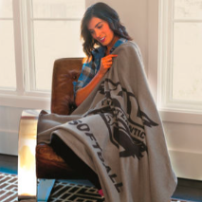
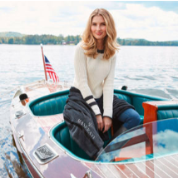
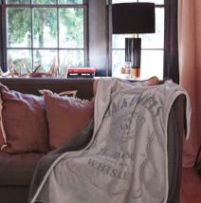
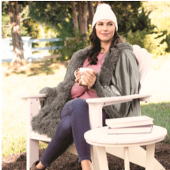
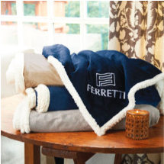
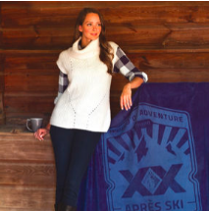
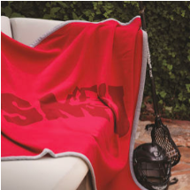
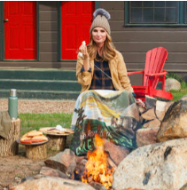
There’s something about our blankets
Deluxe Stonehouse Sweatshirt Blanket
SHSDLX
Brighton Striped Blanket
BMSB
Newcastle Sherpa Blanket
NCSB
Game Day Hooded Blanket
GDHB
Regency Striped Blanket
RFBKT
Oxford Alpaca Blanket
OXBKT
Greystoke
Blanket
GSBKT
Deluxe Fairfield Throw Blanket
FRFDLX
Deluxe Kingston Blanket
KINBXL
Highlander Four Seasons Blanket
HFSB
Mansfield Sherpa Blanket
MMPS

Slide 15
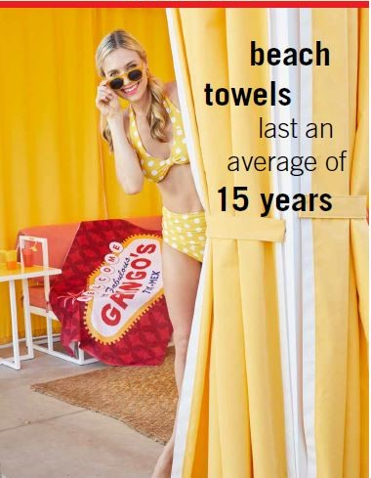
Suddenly, it’s the 2020’s.
Time to ask the big question:
How long have you had your favorite beach towel at home?

Slide 17
Four top four industries use beach towels for:
Employee & Volunteer recognition
Gift with purchase or as an ‘open-an-account’ incentive
Brand awareness
Thank you gift
Referral gift
Work-at-home goodwill gift

Slide 18
#1 User of Beach Towels: The Healthcare Market.
Get ready for Nurse’s Week NOW:
Nurse’s Week used to be a week.
Then it became a month.
With the pandemic, it became an entire year.
It’s scheduled for May 6-12, but orders are already being submitted.
Don’t miss out…get your virtual or random sample order in NOW.

Slide 19
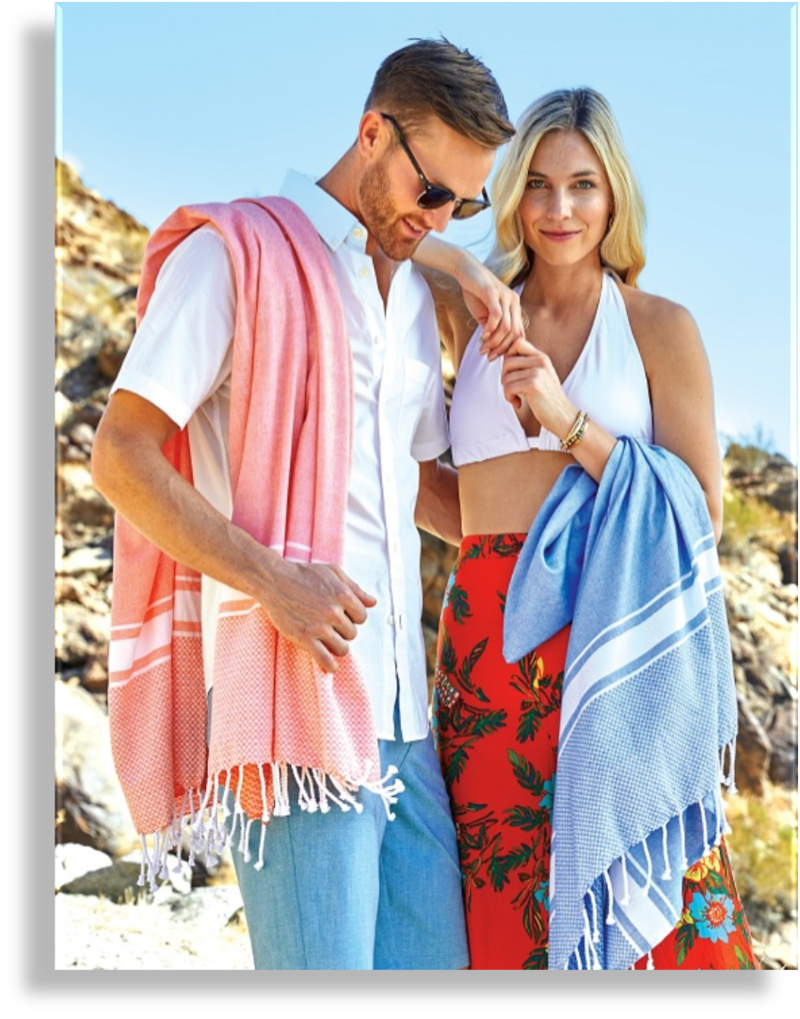
What’s new?

Slide 20
What’s new?
HOT4060
From $36.25(r)
Plush Plus ColorFusion Beach Towel
At 40” x 60” (20 lbs./doz.), this is our largest & heaviest ColorFusion towel.
Edge-to-edge imprint in unlimited colors.
Comes with our exclusive Versa-Loop™ hanging feature sewn into the back.

Slide 21
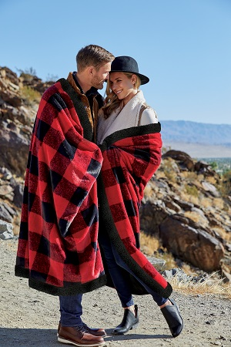
What’s new?
WOODLAND PLAID THROW BLANKET (WPLBKT)
Luxury size 50” x 70”.
Extra-soft brushed velvet on the red/black plaid side, black fabric on the reverse side as cozy as lamb’s wool.
Hidden zippered compartment conceals embroidery backing.
Packaged in vinyl carrying case.

Slide 22
What’s new?
WAVERLY SILVER FOX BLANKET (WSFBKT)
Luxury size 50” x 70”.
Features a soft fur-like ﬁnish in a shimmering light grey wave motif on the back and a silver micro-mink front.
Hidden zippered compartment conceals embroidery backing.
Packaged in vinyl carrying case.

Slide 23
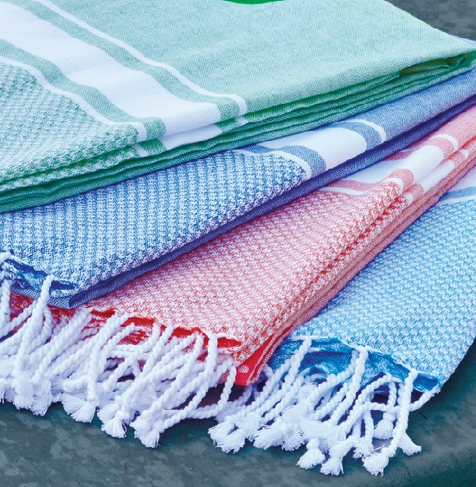
What’s new?
ILPBT
From $20.95(r)
Iliana Peshtemal Beach Towel
A lighter weight style in single ply creation.
Soft pastel colors: lime, royal blue, orange, and turquoise.
Tone on Tone or Embroidery.
35” x 63”.

Slide 24
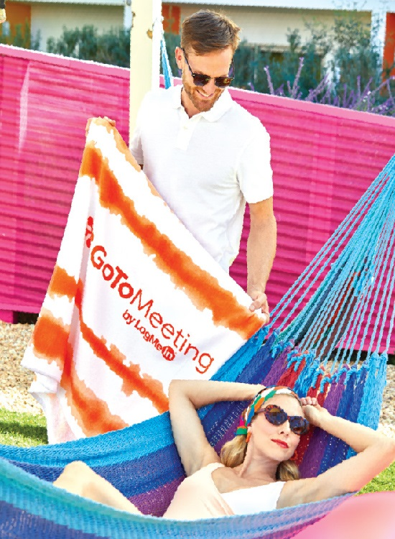
What’s new?
Good Vibes Cabana Stripe Beach Towel
Each towel features multi-tone printed waves.
Available in royal blue, turquoise, orange, lime green or grey.
34” x 66”. 14 lbs./doz
GVCSBT
From $21.95(r)

Slide 25
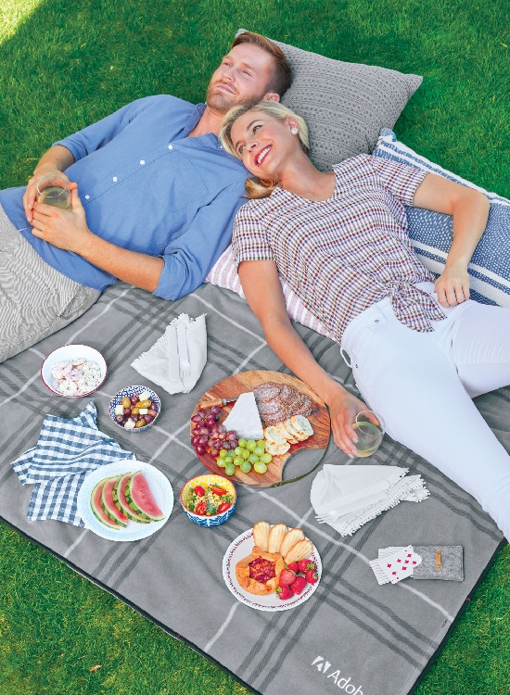
What’s new?
TBPB
From $35.95(r)
Tuscany Backpack Picnic Blanket
Multi-functional 60” x 60 blanket that
folds into a backpack.
Features a grey/white plaid fleece blanket
Water-resistant, ripstop nylon on the reverse side.
Adjustable shoulder straps for easy carrying.

Slide 26
What’s new?
LST40
From $7.95(r)
Fitness Mat Towel™
24” x 72”.
Corner straps anchor towel to yoga mat or chair.
White with royal blue accent piping for either full-color ColorFusion or single color screenprinting.
FMT01
From $19.25(r)

Slide 27
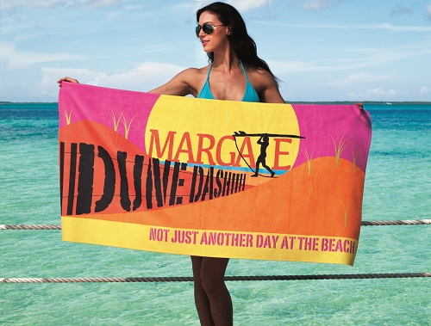
‘thank you’ for today…
Special!
ONE FREE SPEC SAMPLE
May be used for:
Any Color Fusion towel or blanket.
Any embroidered product (up to 8000 stitches)
Any blanket with a laser patch.
Any screen printed product (one color).
Use promo code #PremierGroup2021

